Slide 1
Process
Test Data
Load the Data
& Pre-Process Data
Data Cleaning and Visualization
Training & validation Data
Design a DNN Model
Train the Model
Define
Save the Best Model
Test the Model

Slide 2
Topics
Perception Model to Neural Networks
Activation Functions
Cost Functions
Feed Forwards
Back Propagation

Slide 3
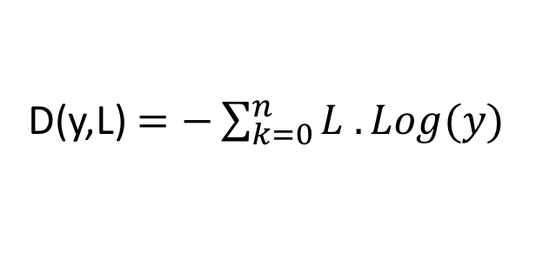
Cross Entropy
Distance Function
y
L
“1”
L
“2”
L
“3”
0.7
0.2
0.1
1.0
0.0
0.0
0.0
1.0
0.0
0.0
0.0
1.0
D(y,L) $=−\sum_{k=0}^{n}{L . Log(y) }$
y dot L1 = - log (0.7) = 0.3566
y dot L2 = -log (0.2) = 1.6
y dot L3 = -log (0.1) = 2.3

Slide 4
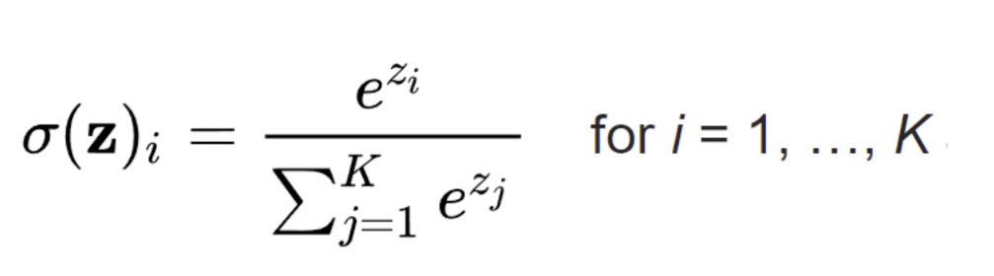
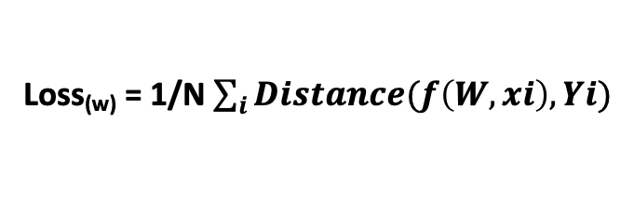


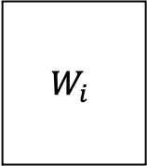
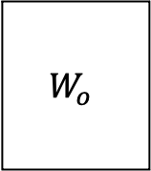

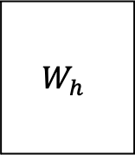

Deep Neural Network (DNN)
X
Y
W₁
B₁
B₂
B₃
W₂
W₃
Softmax
3 Layer Neural Network
Froward Propagation →
Training data
$$x$$
$$W_{i}$$
$$B_{i}$$
$$W_{h}$$
$$B_{h}$$
$$W_{o}$$
$$B_{o}$$
Predicted data
Loss
Stochastic Gradient Descent
Actual data
← Back Propagation
Loss_{(w)} = 1/N $\sum_{i}{Distance(f\left(W,xi\right), Yi)}$

Slide 5
DNN Assignment -1
Representation Learning: We call this vector with lower dimensionality: Latent Features, Feature Representations, or Embedding Representation of the Input) with respect to the learned task.
Vector
Vector
Vector
7
8
4
1
2
8
64
Vector
“3”
₀
₀
₀
₁
₀
₀
₀
₀
₀
₀
x W₁
+
b₁
RELU
x W₂
+
b₂
RELU
x W₃
+
b₃
y
S(y)
[784 x 128]
[128 x 64]
[ 64 x 10]
[1x 784]
x
[784 x 128]
+
[1x 128]
[1x 128]
x
[128 x 64]
+
[1x 64]
[1x64]
x
[64 x 10]
+
[1x 10]
28 X 28 = 784
[28x28] → [1x784]
Flatten a Matrix to a vector
One hot encoding:
Sparse representation of output

